Slide 1
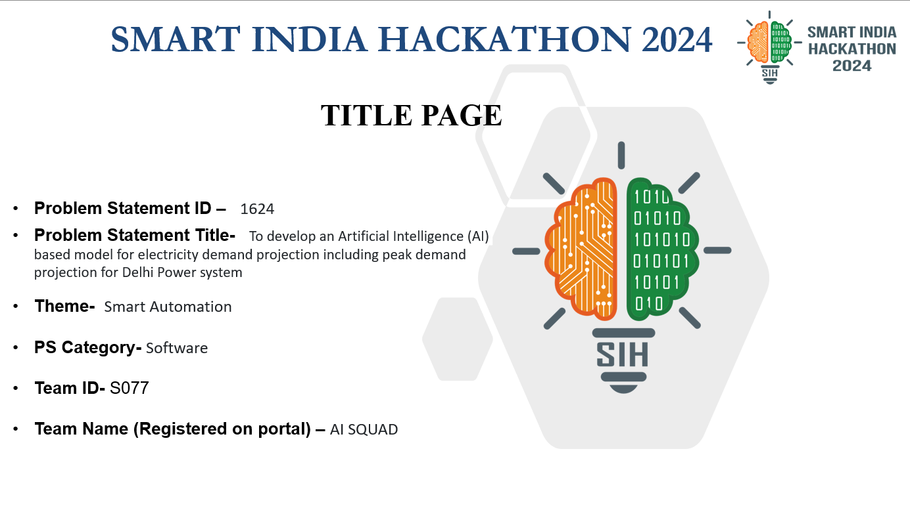

Slide 2










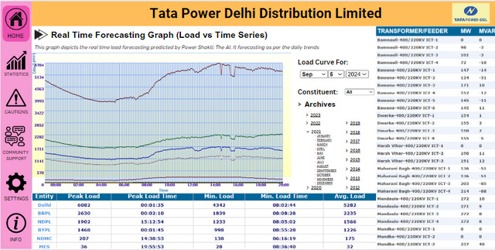



AI
SQUAD
POWER SHAKTI : FORECASTING ELECTRICITY DEMAND
Project Link: https://github.com/Vineetg2003/AI-SQUAD.git
Key Problems We Are Solving
Solving Problems with New Tech
Varying Power demands on Weekends & Holidays
Demand variations with festivals and seasons
Duck Curve Effect
Day-Night Fluctuations
Problems by Old Hardware Detection System
Power Grid Congestion
Aging Infrastructure & Technical Losses
Power Theft & Non-Technical Losses
EV Machines & Their Power Supply
Replacing Fault Detection System
SUBSTATION
(DISCOM)
SMART
SUBSTATION
POWER SHAKTI: THE AI
GRAPHICAL USER INTERFACE
Real-Time Load Forecasting
Fault Detection and Isolation
Predictive Maintenance
Voltage and Frequency Regulation
Energy Theft Detection
Optimization of Power Flow
Enhanced Decision Support
Data Analytics and Reporting
Cybersecurity Monitoring
Consumer Behavior Analysis
Uniqueness & Innovation
Replaces traditional heavy & expensive fault detection hardware with AI-based recognition.
Meets maintenance and infrastructure needs, supporting advanced technology growth.
Transforms the traditional demand-supply graph into a stable, non-fluctuating curve.
AI Model integrated with Scada & DMS system, using GUI
Ensures load forecasting, fault detection & grid stability
Suggest measures to improve response time and minimise disruptions
GUI System displays alerts, warnings, and recommended actions

Slide 3




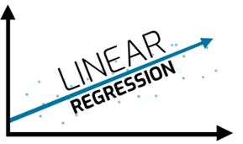











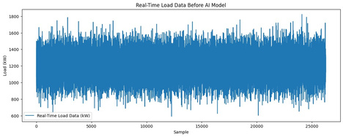


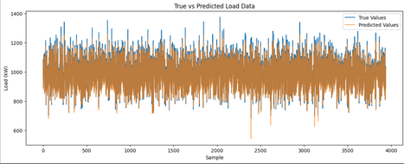

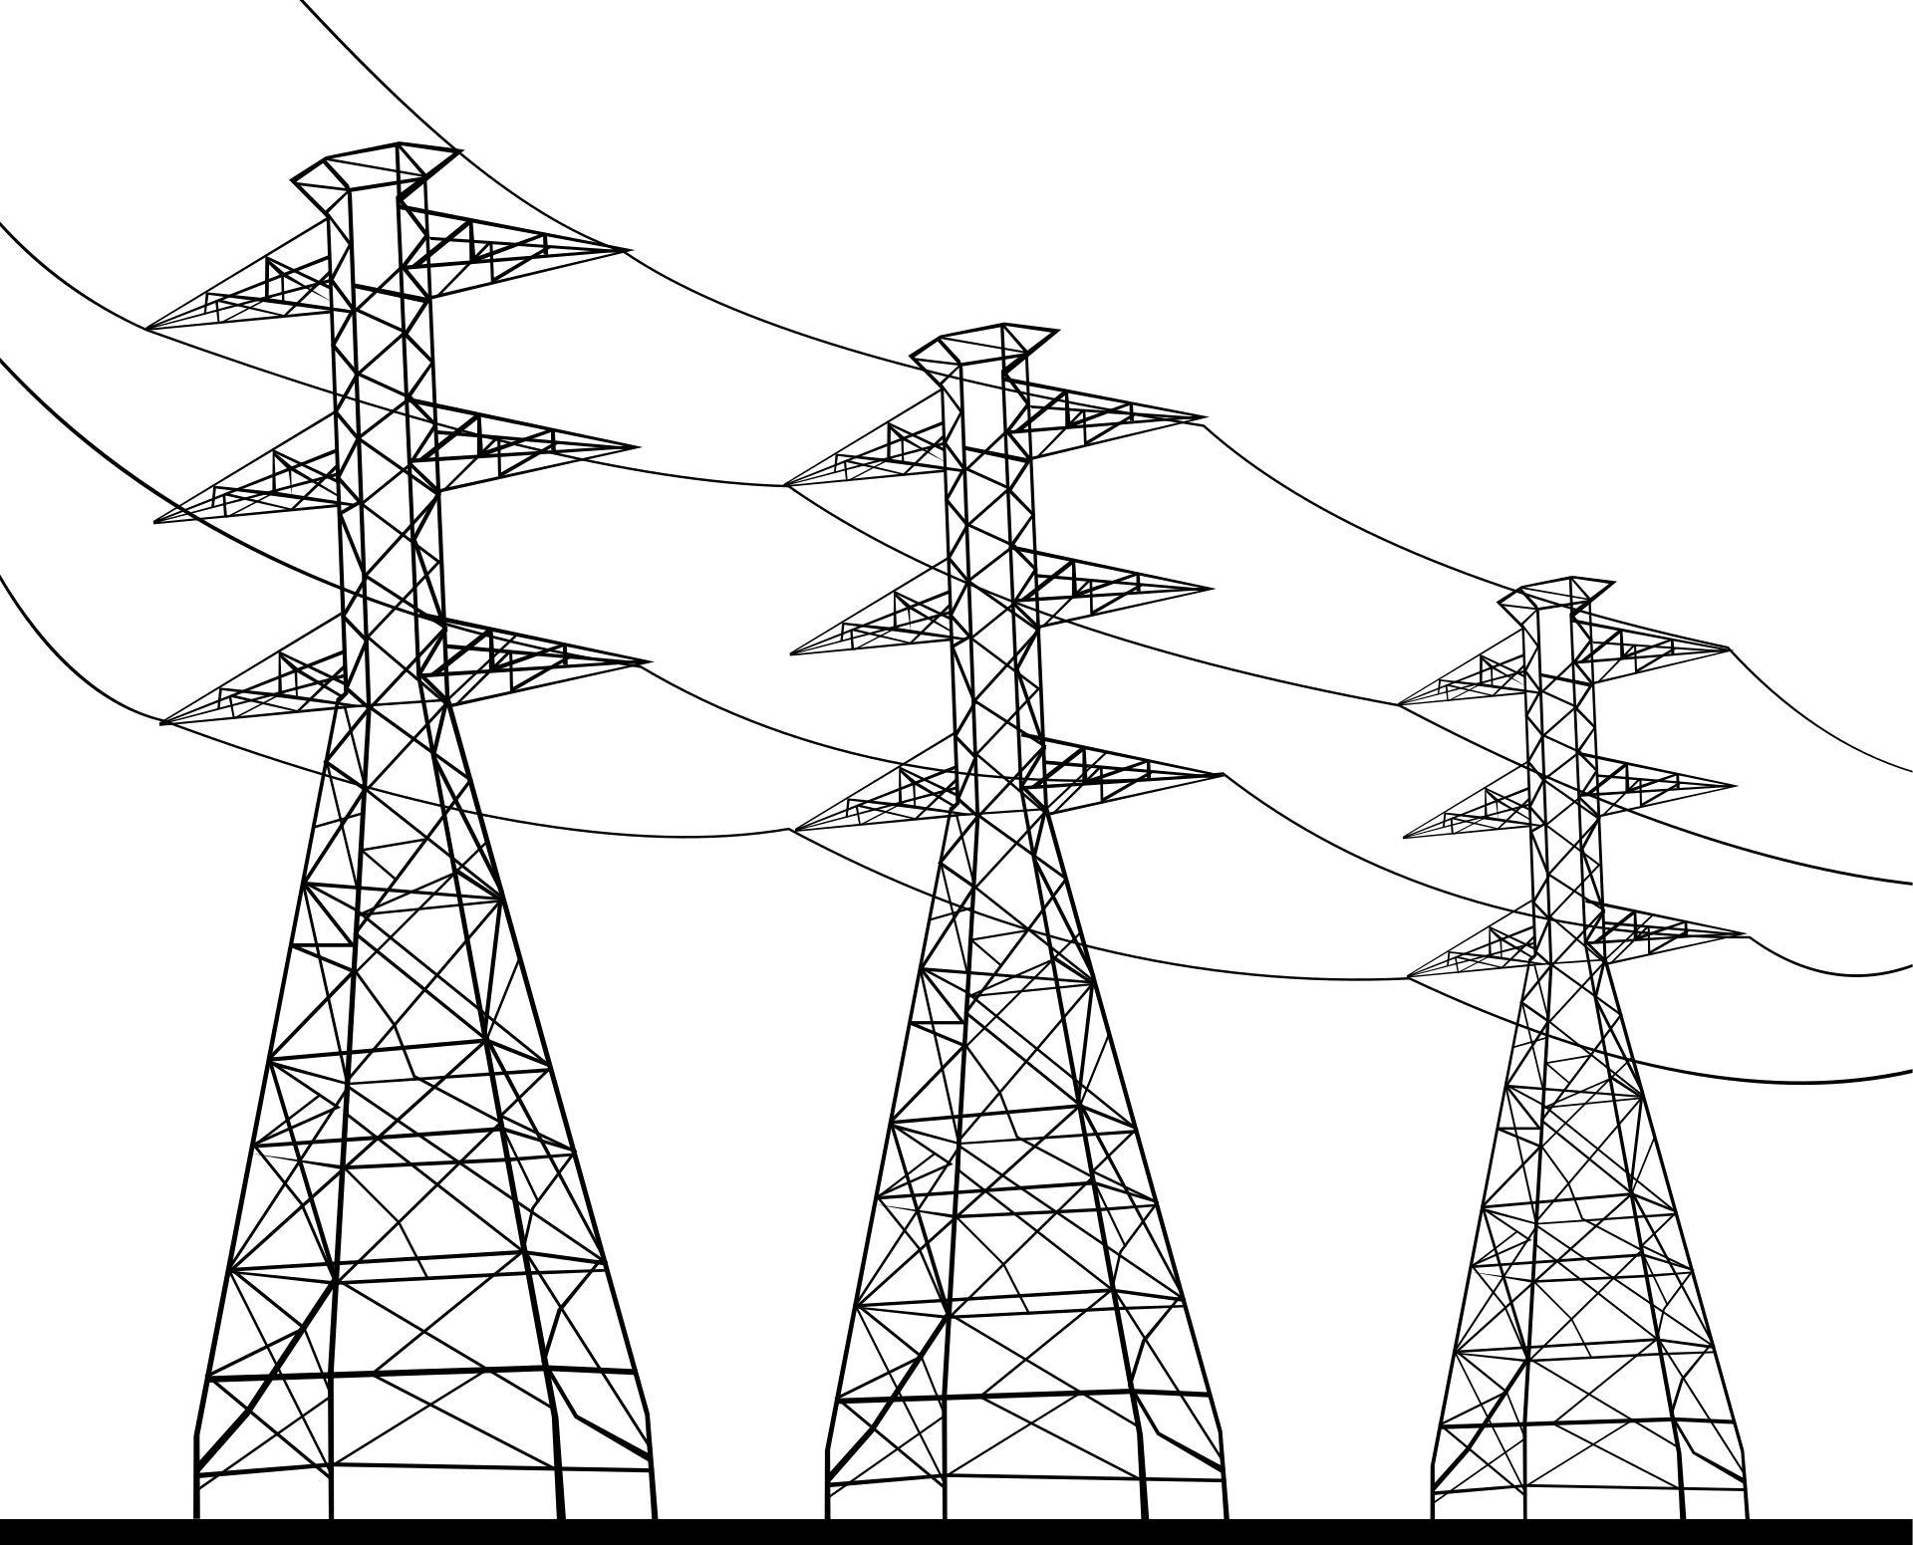

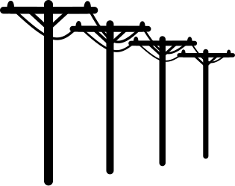


AI
SQUAD
TECHNICAL APPROACH
TECHNOLOGIES USED
IMPLEMENTATION METHODS & PROCESS
Data Training: Initially trained on historical data, with continuous real-time data updates for accuracy and adaptability.
Problem Detection: Utilizes techniques like regression, anomaly detection, and clustering to identify issues based on patterns.
Alerts and Measures: Generates appropriate cautions, warnings, and corrective actions automatically upon detecting problems.
SCADA Integration: Connected to the SCADA system via a GUI, enabling real-time monitoring and instant alerts to the distribution company (DISCOM).
ML MODEL ASSESSMENT
This controls the regoinal electricity board where our AI System will be integrated & will make the system smarter , reliable & effecient.
BEFORE
SUBSTATION
(DISCOM)
AFTER
Accuracy: 0.96
MAE: 18.3
MSE: 420
R2-SCORE: 0.96
Accuracy for the Load Forcasting of Delhi Power Supply

Slide 4

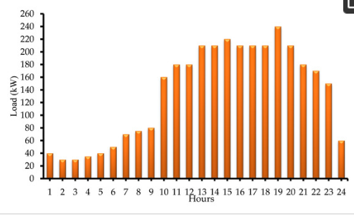
AI
SQUAD
FEASIBILITY AND VIABILITY
FEASIBILITY ANALYSIS
CHALLENGES AND RISKS
Reduction of Fluctuations and Blackouts: Expected to reduce fluctuations, blackouts, and burnouts by over 90%.
Early Detection of Maintenance Issues: Easily identifies maintenance problems and aging infrastructure to prevent system disruptions.
Elimination of Hardware Detection Devices: Reduces the need for separate hardware devices for fault detection.
Stabilized Power Supply: Ensures a stable power supply by aligning generation with predicted usage patterns.
High-Powered System Requirements: The need for a high-powered system to fully train the AI model at such a large scale for Delhi.
Lack of SCADA Data at the public level: Limited access to necessary SCADA data which is crucial for accurate model training and implementation.
OVERCOMING STRATEGIES
The maximum consumption graph predicted by the Model when trained for around 12 years of data.
Accuracy: 0.91
Precision: 0.89
Recall: 0.85
Distributed Training Approach: Use multiple systems to train the AI model, distributing the computational load to fulfill the high powered system requirements.
SCADA Data Access: Aim to gain access to SCADA data as the project scales to higher levels of operation.
Generating Synthetic Data: Utilize Generative AI (GenAI) to create synthetic SCADA data for training purposes when real data is not available.

Slide 5
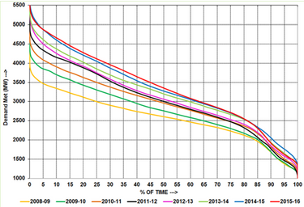
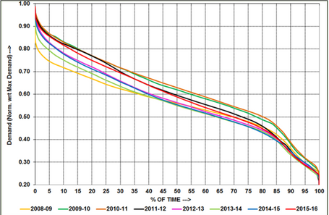
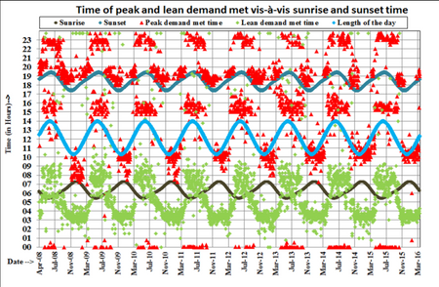
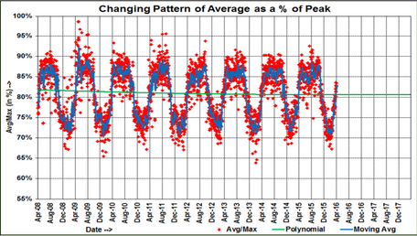
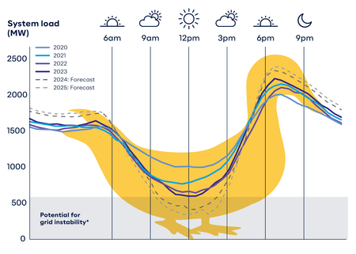
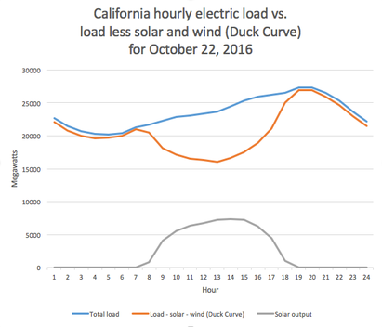

AI
SQUAD
IMPACT AND BENEFITS
The impacts listed below have been tested and validated using our AI model, and the attached graphs and charts provide real data references from our model.
Stabilized Power Generation and Usage: Converts fluctuating power generation vs. usage patterns into a more uniform graph by accurately predicting future demand.
Duck Curve Mitigation: Reduces the curtailment effects of the duck curve, normalizing deep fluctuations.
Cost Reduction: Replaces existing fault detection equipment, lowering overall costs for distribution companies (DISCOMs).
Accurate Usage Predictions: Daily usage prediction graphs are easily generated using data from smart meters and SCADA.
Energy Theft Prevention: Detects energy thefts efficiently using machine learning patterns and data from SCADA and Distribution Management Systems (DMS).
The Duck Curve Mitigation happened by storing the curtailment of the solar power in the batteries & making them use in the night
Annual Demand Duration Curve for the years 2008 - 2016
With applying of the Model Prediction for outages, blackouts & fluctions
Accuracy: 0.98
Time of daily sunset, sunrise with occurrences of peak and lean demand met :
Accuracy: 0.95
Model Predictition of Daily Average demand as a Percentage Peak demand met (Load Factor):
Accuracy: 0.93
BEFORE
AFTER EMBEDDING
AI MODEL

Slide 6

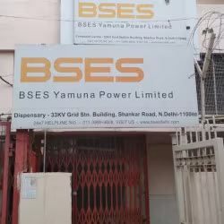
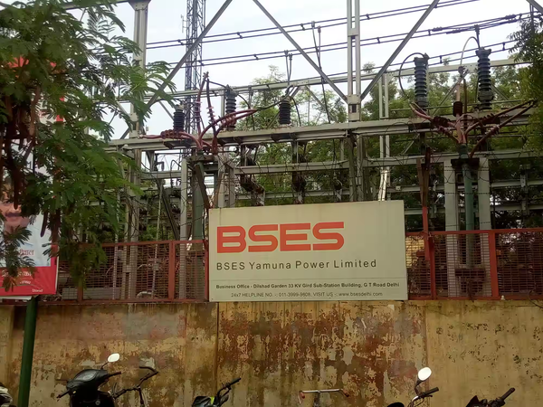
AI
SQUAD
RESEARCH AND REFERENCES
OUTAGES DATA
VISIT BSES 33KV Electric Substation
Rajdhani: https://www.bsesdelhi.com/web/brpl/outage-report
Yamuna: https://www.bsesdelhi.com/web/bypl/outage-report
TATA: https://www.tatapower-ddl.com/scheduleoutage/119/customers/outage-details/scheduled-outage
Got to know how data collection & manupilation on data works
The failures devices which are used and protect the system
Circuit breakers, MCBS, DMS System & IOT Devices used
ML TRAINING DATA
State Load Despatch Center: https://www.bsesdelhi.com/web/brpl/outage-report
Dataset: https://drive.google.com/file/d/1B5FW67q97pXimsKSH5LrrLUUkS6-g3IB/view?usp=sharing
Fault Detection Dataset: https://drive.google.com/file/d/1oiSkGlHe3K8wzsigKGNb8PM15ZXNvBpT/view
Collected the SCADA & DMS Data for training of the Model
Did test analysis of the system which will be integrated
DELHI POWER SYSTEM RESEARCH
Delhi Power System: https://power.delhi.gov.in/sites/default/files/power/circulars-orders/vision_doc_mpd-2041.pdf
Tranmission Reports: https://cea.nic.in/transmission-reports/?lang=en+
Reports & Data: https://cea.nic.in/dashboard/?lang=en
REFERENCE ARTICLES
TEACHERS & THEIR GUIDANCE
https://economictimes.indiatimes.com/news/india/passengers-report-power-outage-at-delhi-airport-boarding-and-check-in-facilities-briefly-impacted/articleshow/111057633.cms?from=mdr
https://www.indiatoday.in/cities/delhi/story/power-outage-in-delhi-due-to-fire-at-up-grid-aap-says-failure-extremely-worrying-2551836-2024-06-11
https://smestreet.in/sectors/servotech-leads-solar-panel-and-charger-installation-4795358
https://www.hindustantimes.com/india-news/several-parts-of-delhi-hit-by-power-outage-minister-atishi-explains-why-101718103163459.html
Mr. Vinay Kumar - AIDS HOD - Idea shaping
Mr. Neeraj Grag - AIML HOD - Helping in Datasets
Ms. Neelam Kesarwani - EEE Department - Helping with faulty system analysis & detection working

